Slide 1
Multimedia Computing
By
Minhaz Uddin Ahmed, PhD
Department of Computer Engineering
Inha University in Tashkent.
Email: minhaz.ahmed@gmail.com

Slide 2
Content
Chapter - 8 (Gonzalez books)
Image compression
Discrete Cosine Transform (DCT)
Coding Redundancy
Interpixel Redundancy
Psychovisual Redundancy
Lossy and lossless example

Slide 3
Objective
Reduce the number of bytes required to represent a digital image
  Redundant data reduction
  Remove patterns
  Uncorrelated data confirms redundant data elimination

Slide 4
Enabling Technology
Compressions is used in
  FAX
  Teleconference
  REMOTE DEMO
  etc

Slide 5
Review
What and how to exploit data redundancy
Model based approach to compression
Information theory principles
Types of compression
  Lossless, lossy

Slide 6
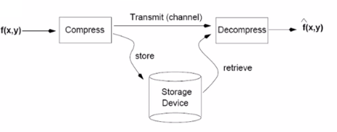
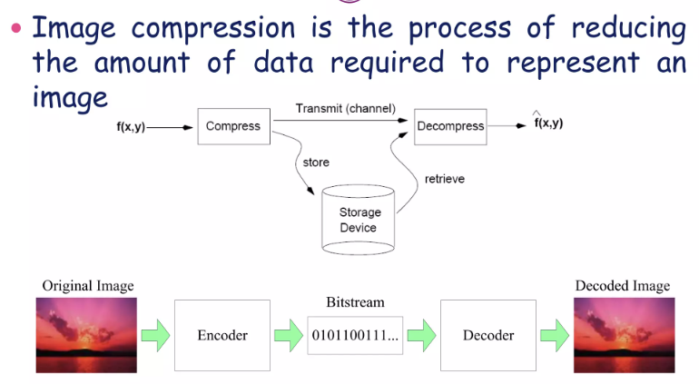
Image compression
Image compression is the process of reducing the amount of data required to represent an image.
Notes:
Image compression is the process of reducing the amount of data required to represent an image.

Slide 7
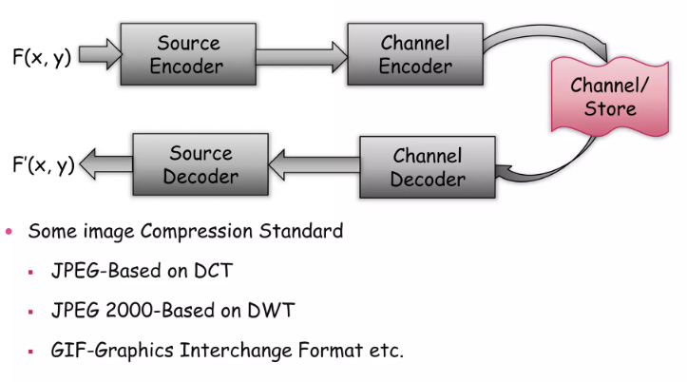
Image compression general models
Some Image compression standard
JPEG-based on DCT (discrete cosine transform)
JPEG 2000 based on DWT (discrete wavelet transform)
GIF-graphics Interchange Format etc.

Slide 8
Discrete cosine transform
The Discrete Cosine Transform (DCT) is a widely used technique in image and signal processing, especially for compression. It transforms a signal or image from the spatial domain (e.g., pixel intensities) to the frequency domain. The DCT is primarily used in image compression techniques such as JPEG because it has the property of concentrating most of the image's information in a small number of frequency components.
DCT transforms a set of data points (e.g., pixels in an image) into a sum of cosine functions oscillating at different frequencies.
In image compression, the DCT is used to decompose an image into its frequency components, where the less important (higher frequency) components can be discarded, significantly reducing the size of the image while maintaining a similar visual appearance.
Notes:
lossless

Slide 9
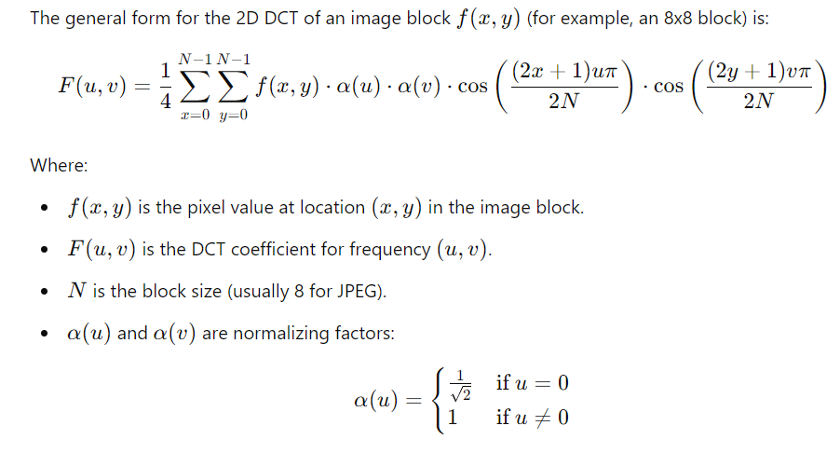
2D Discrete Cosine Transform (DCT):
For images, the 2D DCT is used to transform blocks of the image (typically 8x8 pixel blocks). The DCT transforms the pixel intensities into a set of frequency coefficients.

Slide 10
2D Discrete Cosine Transform (DCT):
Steps in Image Compression with DCT:
1.Block the image: Split the image into non-overlapping 8x8 blocks.
2. Apply 2D DCT: For each block, compute the DCT to transform the spatial domain pixel values into frequency domain coefficients.
3.Quantization: The DCT coefficients are quantized to reduce the amount of data. This step introduces compression by discarding less important high-frequency components.
4.Zigzag scan: The quantized coefficients are ordered in a zigzag pattern to prioritize low-frequency coefficients.
5.Entropy encoding: Techniques like Huffman coding are applied to further compress the data.

Slide 11

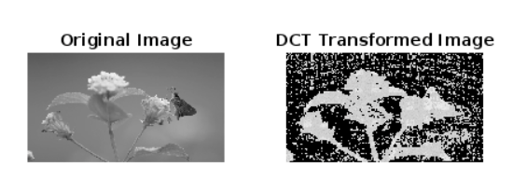
DCT Example
Color image

Slide 12
DCT Example
% Read the image
I = imread('12.jpg');
I_gray = rgb2gray(I); % Convert to grayscale if it's a color image
% Perform DCT on the 8x8 blocks
block_size = 8;
dct_transform = @(block_struct) dct2(block_struct.data);
DCT_image = blockproc(I_gray, [block_size block_size], dct_transform); %%computes the 2D DCT in MATLAB.
% Display original and DCT-transformed images
subplot(1, 2, 1);
imshow(I_gray);
title('Original Image');
subplot(1, 2, 2);
imshow(log(abs(DCT_image)), []);
title('DCT Transformed Image');

Slide 13
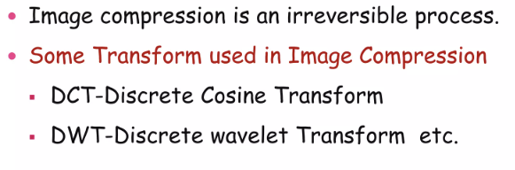
Information recovery
Processing
Data
Information
We want to recover the information, with reduced data volumes.
Reduce data redundancy.
How to measure the data redundancy.

Slide 14
Relative Data Redundancy
Assume that we have two data sets D₁ and D₂.
  Both on processing yield the same information.
  Let n₁ and n₂ be the info – carrying units of the respective data sets.
  Relative data redundancy is defined on comparing the relative dataset sizes
R_{D} = 1 – 1/C_{R}
where C_{R} is the compression ratio
C_{R} = n₁ / n₂

Slide 15
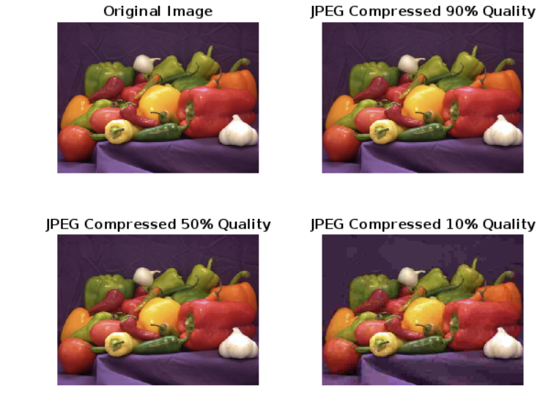
Relative Data Redundancy

Slide 16
Code lossy
>> img = imread('peppers.png');
>> imshow(img), title('Original Image');
>> % Step 2: Save the image with different JPEG quality levels
imwrite(img, 'compressed_image_90.jpg', 'jpg', 'Quality', 90); % 90% quality
imwrite(img, 'compressed_image_50.jpg', 'jpg', 'Quality', 50); % 50% quality
imwrite(img, 'compressed_image_10.jpg', 'jpg', 'Quality', 10); % 10% quality
>> % Step 3: Read and display the compressed images
img_90 = imread('compressed_image_90.jpg');
img_50 = imread('compressed_image_50.jpg');
img_10 = imread('compressed_image_10.jpg');
>> figure;
subplot(2, 2, 1), imshow(img), title('Original Image');
subplot(2, 2, 2), imshow(img_90), title('JPEG Compressed 90% Quality');
subplot(2, 2, 3), imshow(img_50), title('JPEG Compressed 50% Quality');
subplot(2, 2, 4), imshow(img_10), title('JPEG Compressed 10% Quality');
>>
Lower quality values result in more compression but also greater loss of image fidelity.

Slide 17
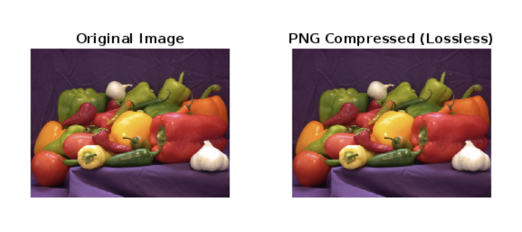
Loss less
PNG uses lossless compression, meaning the compressed image will be exactly the same as the original in terms of pixel values, but with a smaller file size.

Slide 18
Code lossless
>> img = imread('peppers.png');
>> imwrite(img, 'compressed_image_lossless.png', 'png');
>> img_png = imread('compressed_image_lossless.png');
>> figure;
subplot(1, 2, 1), imshow(img), title('Original Image');
subplot(1, 2, 2), imshow(img_png), title('PNG Compressed (Lossless)');

Slide 19
File size of compressed image
% Check the file sizes of the compressed images
original_info = dir('peppers.png');
jpeg_90_info = dir('compressed_image_90.jpg');
jpeg_50_info = dir('compressed_image_50.jpg');
jpeg_10_info = dir('compressed_image_10.jpg');
png_info = dir('compressed_image_lossless.png');
fprintf('Original Image Size: %d bytes\n', original_info.bytes);
fprintf('JPEG 90%% Quality Size: %d bytes\n', jpeg_90_info.bytes);
fprintf('JPEG 50%% Quality Size: %d bytes\n', jpeg_50_info.bytes);
fprintf('JPEG 10%% Quality Size: %d bytes\n', jpeg_10_info.bytes);
fprintf('PNG Lossless Size: %d bytes\n', png_info.bytes);
Original Image Size: JPEG 90% Quality Size: 41327 bytes JPEG
50% Quality Size: 15671 bytes JPEG
10% Quality Size: 6619 bytes PNG Lossless Size: 287589 bytes

Slide 20
Examples
R_{D} = 1 – 1/C_{R}
C_{R} = n₁ / n₂
D₁ is the original and D₂ is compressed.
When C_{R} = 1, i.e. n₁ = n₂ then R_{D}=0; no data redundancy relative to D₁ .
When C_{R} = 10, i.e. n₁ = 10 n₂ then R_{D}=0.9; implies that 90% of the data in D₁ is redundant.
What does it mean if n₁ << n₂ ?

Slide 21
Types of data redundancy
Coding Redundancy– Occurs when the data used to represent the image is not utilized in an optimal manner
Interpixel Redundancy – Occurs because adjacent pixels tend to be highly correlated, in most images the brightness levels do not change rapidly, but change gradually.
Psychovisual Redundancy- Some information is more important to the human visual system than other type of information.

Slide 22
Coding Redundancy
How to assign codes to alphabet
In digital image processing
  Code = gray level value or color value
  Alphabet is used conceptually
General approach
  Find the more frequently used alphabet
  Use fewer bits to represent the more frequently used alphabet, and use more bits for the less frequently used alphabet

Slide 23
Coding Redundancy 2
Focus on gray value images
Histogram shows the frequency of occurrence of a particular gray level
Normalize the histogram and convert to a pdf representation
let r_{k} be the random variable
  p_{r}(r_{k}) = n_{k}/n ; k = 0, 1,2 …., L-1, where L is the number of gray level values
  l(r_{k}) = number of bits to represent r_{k}
  L_{avg} = Σ_{k=0 to L-1} l(r_{k}) p_{r}(r_{k}) = average number of bits to encode one pixel. For M x N image, bits required is MN L_{avg}
  For an image using an 8 bit code, l(r_{k}) = 8, L_{avg} = 8.
  Fixed length codes.

Slide 24
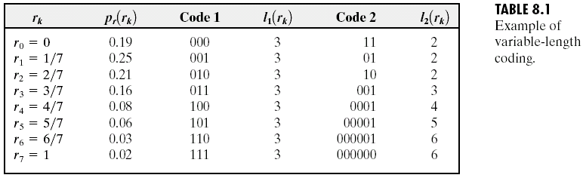


Fixed vs Variable Length Codes
Lavg = 2.7
C_{R}= 3/2.7 = 1.11
R_{D} = 1 – 1/1.11 = 0.099

Slide 25
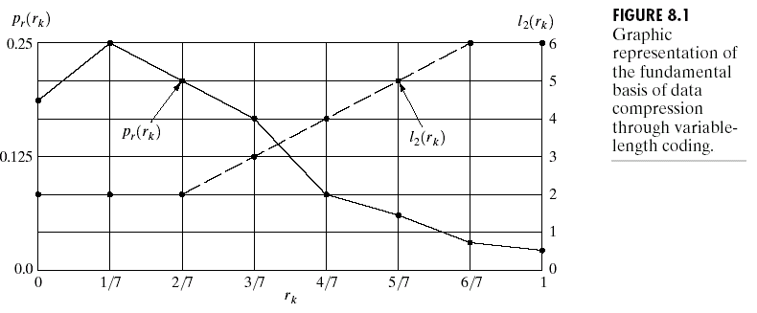
Code assignment view

Slide 26
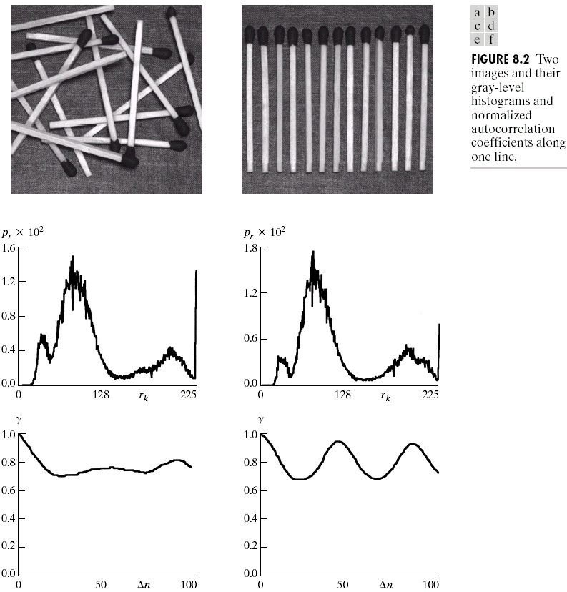
Interpixel Redundancy

Slide 27
Interpixel Redundancy
Inter-pixel Spatial redundancy:
Inter-pixel redundancy is due to the correlation between the neighboring pixels in an image.
The value of any given pixel can be predicted from the value of its neighbors(Highly correlated)
The information carried by individual pixel is relatively small.
To reduce inter-pixel redundancy the difference between adjacent pixels can be used to represent an image.
Inter-pixel Temporal Redundancy
Inter-pixel temporal redundancy is the statistical correlation between pixels from successive frames in video sequence.
Temporal redundancy is also called inter-frame redundancy.
Removing a large amount of redundancy leads to efficient video compression.
Algorithm: Run Length Coding

Slide 28
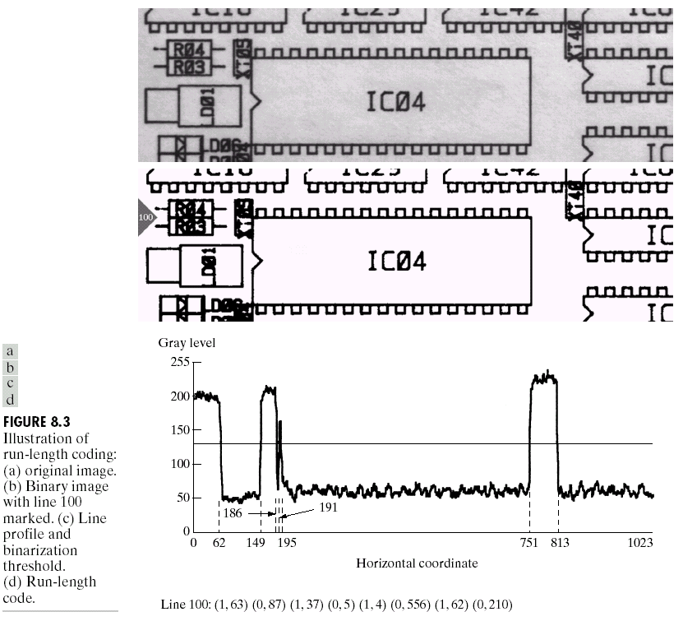
Run Length Coding
CR=1024*343/12166*11
= 2.63
RD = 1-1/2.63 = 0.62
Notes:
RD -> redundacy

Slide 29
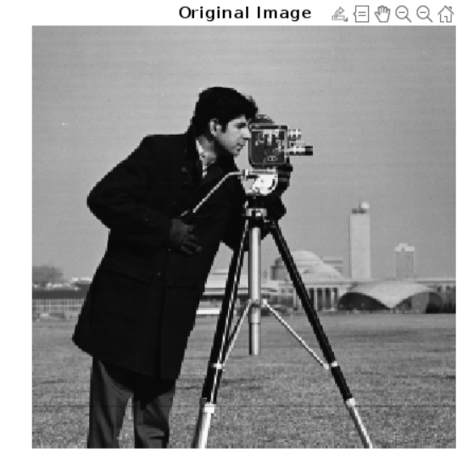
Run Length Coding
Run Length Encoding (RLE) is a simple form of lossless compression that is particularly useful for images with many consecutive identical pixel values, such as binary or grayscale images.
Original Size: 65536 bytes
Compressed Size: 112224 bytes
Compression Ratio: 1.71

Slide 30
Run Length encoding
% Read an image (grayscale image for simplicity)
image = imread('cameraman.tif'); % Example image (grayscale)
imshow(image);
title('Original Image');
% Flatten the 2D image into a 1D array
image_vector = image(:);
% Initialize variables
value = image_vector(1); % First pixel value
count = 1; % Counter for run length
encoded_values = []; % Encoded pixel values
run_lengths = []; % Encoded run lengths

Slide 31
Run Length encoding
% Run Length Encoding loop
for i = 2:length(image_vector)
if image_vector(i) == value
% If the current pixel matches the previous one, increase the count
count = count + 1;
else
% Store the previous pixel value and its run length
encoded_values = [encoded_values value];
run_lengths = [run_lengths count];
% Reset for the new pixel value
value = image_vector(i);
count = 1;
end
end
% Add the last pixel value and its run length
encoded_values = [encoded_values value];
run_lengths = [run_lengths count];

Slide 32
Run Length encoding
% Display the encoded values and run lengths
disp('Encoded Values:');
disp(encoded_values);
disp('Run Lengths:');
disp(run_lengths);
% Compression Ratio Calculation
original_size = length(image_vector);
compressed_size = length(encoded_values) + length(run_lengths);
compression_ratio = compressed_size / original_size;
fprintf('Original Size: %d bytes\n', original_size);
fprintf('Compressed Size: %d bytes\n', compressed_size);
fprintf('Compression Ratio: %.2f\n', compression_ratio);

Slide 33
Run Length encoding
Image Input: We load a sample grayscale image using imread.
Flattening the Image: The 2D image is flattened into a 1D vector using image(:).
Run Length Encoding: We loop through the image vector, counting consecutive identical pixel values (runs). When a change is detected, we store the pixel value and the run length.
Output: The encoded values and run lengths are printed. Additionally, the compression ratio is calculated by comparing the original and compressed data sizes.

Slide 34
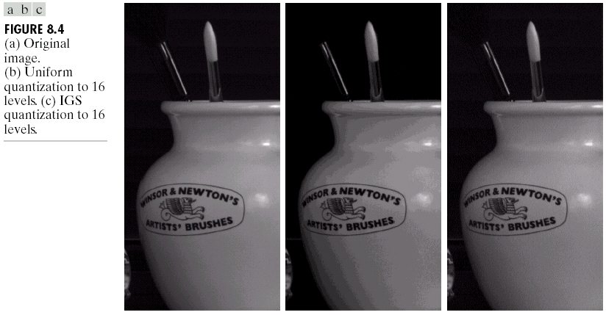
Psychovisual Redundancy
Some visual characteristics are less important than others.
In general observers seeks out certain characteristics – edges, textures, etc – and the mentally combine them to recognize the scene.

Slide 35
Psychovisual Redundancy
If the image will only be used for visual observation, a lot of the information is usually psycho-visual redundant. It can be removed without changing the visual quality of the image. This kind of compression is usually irreversible.
The psychovisual redundancy exist because human perception does not involve quantitative analysis of every pixel or luminance value in the image.
It’s elimination is real visual information is possible only because the information itself is not essential for normal visual processing.

Slide 36
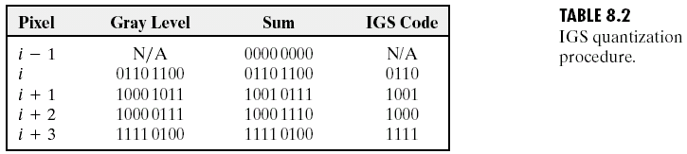
Psychovisual Redundancy

Slide 37
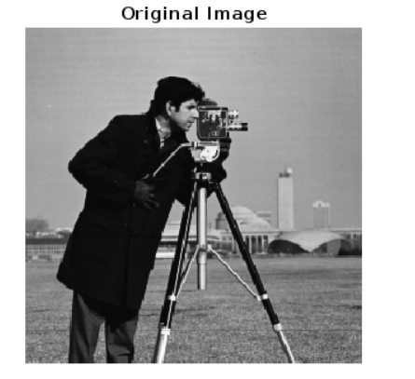
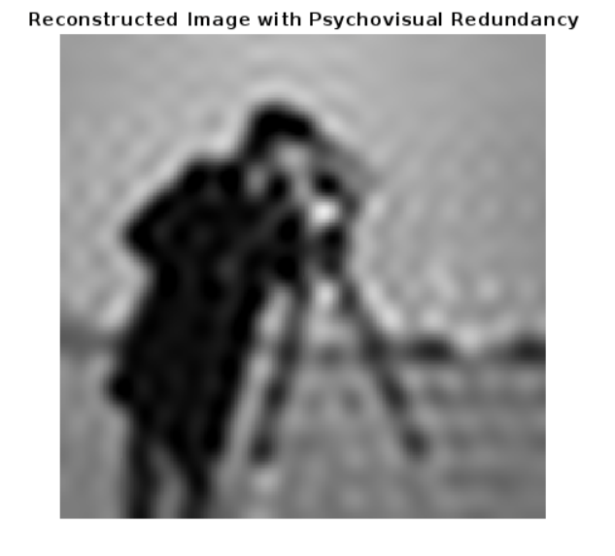
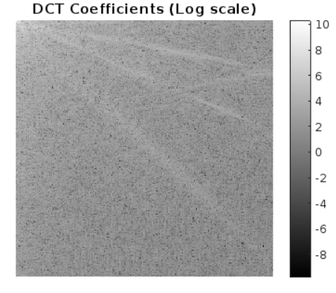
Psychovisual Redundancy

Slide 38
Psychovisual Redundancy
Step 1: Read the grayscale image (for simplicity, we'll use a grayscale image)
Step2: Perform 2D Discrete Cosine Transform (DCT) to the image
Step3: Visualize the DCT coefficients
Step 4: Zero out high-frequency components (higher psychovisual redundancy)
% Keep only a part of the low-frequency DCT coefficients, set the rest to 0
% Here, we'll retain only the top-left 10% of DCT coefficients.
Step 5: Apply the mask to keep only low-frequency components
Step 6: Reconstruct the image using the inverse DCT (IDCT)
Step 7: Display the reconstructed image

Slide 39
Fidelity Criteria
Subjective
Objective
  Sum of the absolute error
  RMS value of the error
  Signal to Noise Ratio
Notes:
faithfulness

Slide 40
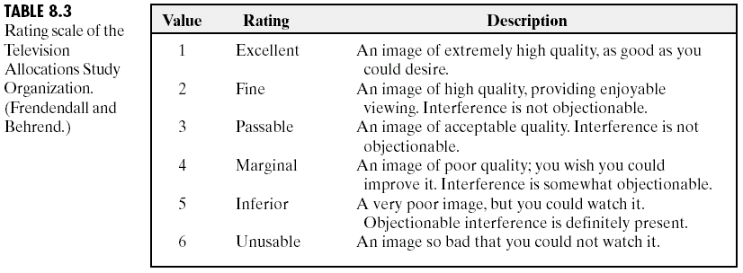
Subjective scale

Slide 41
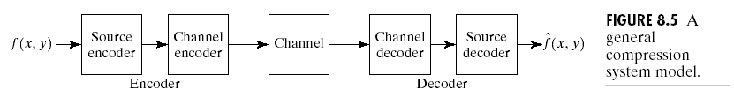
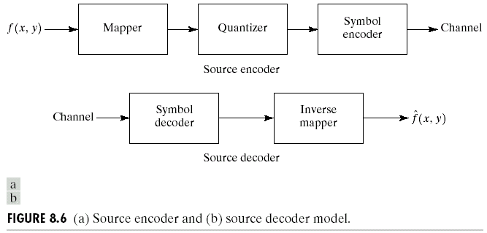
Image Compression Model

Slide 42

Reference
Chapter 8

Slide 43

Question

Slide 44

Thank you

